Slide 1
Building Brain 4.0 Team Member(s): Emmanuel Vinas, Justin Fletcher Product Owner(s): Ali Mostafavi, Leonardo Bobadilla
Instructor: Masoud Sadjadi School of Computing and Information Sciences Florida International University
Senior Project Final Presentation Spring 2016
03/07/2016
Notes:
Greet your audience, thank them for attending your presentation, introduce yourself, introduce your project, introduce your team members, and quickly indicate what each of you did in a high-level manner, and put more emphasis on your part/contribution.

Slide 2
Problem definition
Problem: There is a working app but no building to integrate with.
Hardware too expensive
Takes too long to install
Testing is affected
Whole Project:
Create a Simulation to test the functionality of the Smart Building application with in a realistic lighting environment.
My Part:
Modeling, Lighting, and Creating components to create and effective simulation to test android application functionality
Notes:
Introduce the problem that the whole project tackles and stay focused on the parts that you have been working. Indicate if there is an existing previous system, enumerate its problems/limitations, etc.

Slide 3
Project Management
 | Week 1 | Week 2 | Week 3 | Week 4 | Week 5 | Week 6
Sprint 1
Light Emission
Sprint 2
3D Model- House
Day and Night Cycle
Character Controller
Sprint 3
Notification System
Notes:
Project Management (schedule for entire semester) (one slide; Gantt Chart).

Slide 4
Requirements: User Stories
User Story #725: Create Light Emission
User Story #727: Control Character
User Story #732: Notification System
User Story #754: Day and Night Cycle
User Story #747: 3D Model House
The Character Controller: without mouse use
Day and Night Cycle: simulate Daytime and nighttime lighting
Notification System: keeps track of Energy usage from light and plug load to create monitoring possible in simulation
Notes:
4. Requirements:
4.1. User stories implemented (one or more slides).
4.2. UML use cases and the use case diagram for the implemented use cases (one or more slides).
4.3. UML sequence diagrams for the implemented use cases.

Slide 5
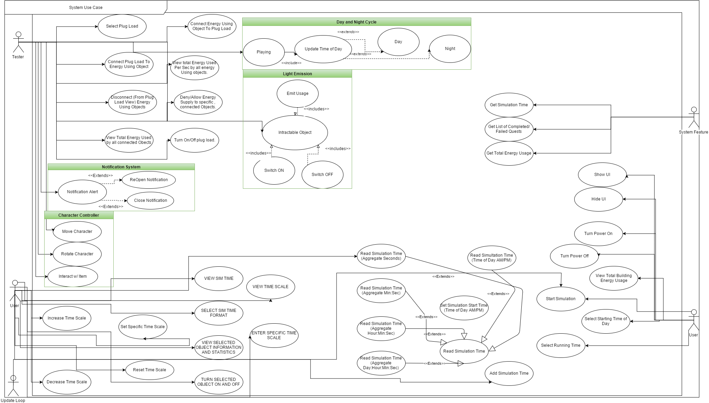
Requirements: Use Cases
Show all the details of the most significant use case.
Notes:
4. Requirements:
4.1. User stories implemented (one or more slides).
4.2. UML use cases and the use case diagram for the implemented use cases (one or more slides).
4.3. UML sequence diagrams for the implemented use cases.

Slide 6
Notification System
Description:
As a tester, I would like to receive simulated Notifications in the simulation so that they can be tested before using a notification system directly to the Application on an Android device.
Acceptance Criteria:
Simulates the receipt of a Notification within the simulation.
Knows the time of the notification, to know how fast it was responded to.
Knows what actions were taken if any in response to the notification.
Should be able to display any message based on the context of the notification being sent. Such as “Turn off the light in room x”.
Related Tasks:
Part of a larger task of creating a simulated android device within the simulation that has some of the basic features of the application, for testing purposes.

Slide 7
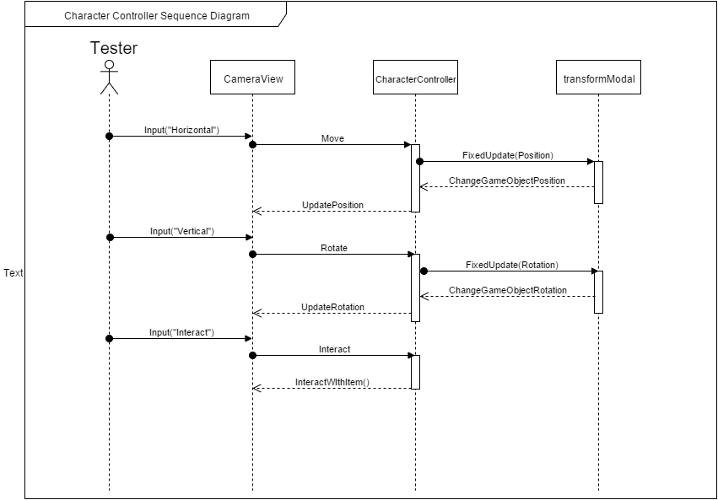
Requirements: Sequence Diagrams
Notes:
4. Requirements:
4.1. User stories implemented (one or more slides).
4.2. UML use cases and the use case diagram for the implemented use cases (one or more slides).
4.3. UML sequence diagrams for the implemented use cases.

Slide 8
System Design: Architecture
Simulation Assets
Our Components
Other Assets
UNITY
GAME
ENGINE
View Scripts
3D Models / Textures / Audio
Controller Scripts
Unity Components
Modal Scripts
Game Objects (Entities)
‹#›
Notes:
5. System design:
5.1. System decomposition; identify the architecture patterns used (one slide).
5.2. System deployment – h/w and s/w requirements (one slide).
5.3. Persistent data design (one slide).
5.4. Security/Privacy (one slide).

Slide 9
System Design: Deployment
Local Machine
Local Storage:
Saving Data / Statistics for each simulation
Simulation Program:
Series of scripted events
Reaction to user input
User feedback
User Interaction:
Mouse, Keyboard, Controller, Oculus.
Notes:
5. System design:
5.1. System decomposition; identify the architecture patterns used (one slide).
5.2. System deployment – h/w and s/w requirements (one slide).
5.3. Persistent data design (one slide).
5.4. Security/Privacy (one slide).

Slide 10
Minimal Class Diagram
NotificationView
NotificationModel
TimeScale
DayNightController
TimeScaleController
<<extends>>
Observes
Time
TimeTracker
NotificationController
<<extends>>
<<extends>>
Uses
User View
<<extends>>
TimeTrackerController
<<extends>>
<<extends>>
Transform
<<extends>>
MonoBehaviour
<<extends>>
Observes
Time
<<extends>>
HUDView
HUD
CharacterController
<<extends>>
<<extends>>
<<extends>>
<<extends>>
<<extends>>
<<extends>>
<<extends>>
SimObject
Displays
HUDController
UIEnergyUsingObject
<<extends>>
<<extends>>
<<extends>>
EnergyUsingObject
PlugLoadController
<<extends>>
EmissionController
Plugged In
Battery
EnergyUsage
PlugLoadView
PlugLoad
EmissionTracker
EmissionView
‹#›
Notes:
6. Detailed design:
6.1. Minimal class diagram. Identify the design patterns used (one or more slides).
6.2. State machine for the main control object or the most important object of the implemented uses cases (one or more slides).
6.3. Main algorithm used related to an implemented use case described above (one or more slides).

Slide 11
Main algorithm
[Day Night Cycle]
float dRange = 1 - minP;
float dot = Mathf.Clamp01 ((Vector3.Dot (sun.forward, V3.down) - minP) / tRange);
float i = ((maxInten - minInten) * dot) + minInten;
mainLight.intensity = i;
if (dot > 0)
Rotate (daySpeed * Time.deltaTime * skySpeed);
else
Rotate (nightSpeed * Time.deltaTime * skySpeed);
Notes:
6. Detailed design:
6.1. Minimal class diagram. Identify the design patterns used (one or more slides).
6.2. State machine for the main control object or the most important object of the implemented uses cases (one or more slides).
6.3. Main algorithm used related to an implemented use case described above (one or more slides).

Slide 12
Test Case
TestID: Notification_001
Objective: Notification Pop up is enabled when the model emission has passed a certain limit. It will give detail on the room name, and the amount of emission it is giving off. The space bar will close the popup and add it to the quest panel that can be viewed when pressing ‘i’.
Steps:
Set Limit, input room names in the model script.
Add a random number b/w 1 - 10 to emission every frame.
If popup, press Spacebar to close.
If disabled press ‘i’ to open quest panel
Expected Results:
The popup should have faded in with the inputted room names, and their respective emission levels in the info section. SpaceBar should have slowly faded out the panel ‘i’ should have shown a panel at the bottom with the quest info buttons.
Notes:
7. Test Suites and Test Cases (one sunny day and one rainy day) for the use case represented in part (5) above (2 slides).
7.1 One sunny day and one rainy day for the implemented use cases (one or more slides).
7.2 Automated test scripts for the implemented use cases (one or more slides).

Slide 13
Summary
Building a simulation to test android application in Unity engine in order to test effectiveness in an affordable manner.
email: emvina@fiu.edu
Notes:
Summarize your contribution
Include your contact information
Ask if anyone has any questions for you.
Thank your audience

Slide 14
Thank you!

